Slide 1

Price Promotion Modelling Capabilities
Advanced Analytics Capabilities
Ability to understand Nielsen/Circana and other CPG/retail data sources
Implemented Trade Promotion tools to optimize strategies
Built strategies to target price promotions to key segments for higher conversions
Deep experience with Price Promo Impact on ROI
Ability to customize for Business needs
Ability to scale quickly
Optimization-driven decision support | Enhanced Revenue and Margin Growth | Provide End to End Solution
Experience with Fortune 500 Companies
1
2
3
Built a Promo Simulator to forecast future sales and uplift across promotion types and categories, helping a Transnational CPG Major drive a 4% increase in uplift in revenue realization
Helped a Global Cosmetic Leader optimize promotional investments by identifying low-ROI activities and scaling high-impact tactics, leading to a 6% increase in uplift in revenue realization.
Enabled a Global Tobacco Major to forecast market volumes and simulate both own and competitor pricing moves, driving smarter portfolio strategies and delivering a 5% increase in uplift in revenue realization
© Proprietary & Confidential. All rights reserved.
Notes:
Price Promotion Modeling Insights Generation from Discrete Or Survey Based non-Sales POS Data Other Insights generation from panel Data

Slide 2





Tested Framework to Building Scalable Price & Promo Solutions
Data Foundation & Preparation
EDA & Descriptive Analytics
Modeling & Insights
Trade Promo Optimization
Trade Promo Management
Identify and extract relevant data (e.g., POS, Panel & Internal Data)
Extract, clean, merge and standardize data
Build integrated, structured & coherent master datasets
Identify top brands, retailers, and PPGs driving volume and profit
Profile key shopper groups based on volume and strategic value
Model POS data to estimate base price and promo price elasticity.
Model panel data and calibrate elasticities using POS models
Survey to understand shopper purchase attitudes with price changes.
Define specs and design a price simulation ad optimization tool
Develop and deploy the tool
Run scenarios to identify performance improvement
Design and develop a planning tool to manage promo calendars by retailer & week (specs TBD)
Deploy tool
Run scenarios to maximize the performance
Create data sets ready for EDA & modeling
Understand key drivers of historical performance
Price Elasticities
Key insights from modeling phase
Tool for simulation and optimization
Recommendations for price & promos
Price and Promotion calendar for selected retailers and brands

Slide 3


1. Data Prep
From Data to Decisions: Structuring the Foundation for Price & Promo Modeling
Data Sources
Output Layer (Model Ready Dataset)
Structured dataset with:
Brand × Week × Region × Channel level view
Clean fields for base price, promo price, promo type (TPR, Display, Feature), promo flags & duration
The Dataset is now ready for:
Elasticity modeling
Promo simulation
TPO recommendations
Internal
Mondelez Sources
Nielsen POS Data
Nielsen Panel Data
External Data Sources
ERP/Finance Systems (e.g., trade spend, list price, claims)
TPM or TPO tools (promo calendars)
Weekly brand-level sales, pricing, promo depth, promo mechanics
Retailer, region, channel breakdown
Household-level demographics, trips, units, channel/shopper info
Competitor pricing & promotion benchmarks
Weather, seasonality, macro trends
Data Preparation Process
DATA CLEANING & ENRICHMENT
Clean up the data collected from internal and external sources
Harmonize hierarchies: Brand, SKU, Pack Size, Retailer, and Region
DATASET STRUCTURING
Finalize schema for brand × week × channel x region level
Ensure model-critical fields: base price, promo price, segment tags
DATA INTEGRATION
Collect data from POS, Panel, and Internal systems (e.g., TPM, Finance)
Consolidate across brands, retailers, markets, and timeframes
DATA STORAGE & ACCESSIBILITY
Store in a structured format (data lake, warehouse, or modeling layer)
Ensure accessibility for downstream tools (TPO, simulation engines, dashboards)
1
3
5
2
DATA VALIDATION
Benchmark key fields (price, volume, promo) against business baselines
Flag anomalies that may impact model integrity
4
SE
E
6

Slide 4
2.Descriptive Analysis
Panel - Identifying and Targeting the Right Shopper Cohorts
Decode shopper segment behaviors (by age, income, household size) using panel KPIs — such as penetration, frequency, and spend per trip — to uncover whitespace & growth opportunities.
YoY Growth for Penetration, Purchase Size & Frequency
Panel - Illustrative
Business Outcome
Identify high-potential consumer segments
Identify of white space opportunities within shopper segments
Understand the key levers of own brands vs competition
Where can we unlock value for Mondelez?
Which cohorts need to be looked at?
Medium Income Group
High Income group
Low Income Group
Overall Market Growth (YoY)
Medium Income Group
Low Income Group
High Income Group
Own Penetration Growth (YoY)
*All figures shown are indicative and intended solely for representation

Slide 5







3.Modelling
Price Promo Optimisation Engine implemented for Fortune 20 CPG company
ELASTICITY ENGINE
OPTIMIZER ENGINE
Input Measures/Facts
Maximizing portfolio performance by identifying most optimal Pricing & Promo Combinations.
Price/Volume
- Base Price/Volume
- Promo price/Volume
- Promo Conditions
Other
- Seasonality & Trend
- Holidays
- Lagged Variables
- Macroeconomic Var. (CPI)
Optimize Base /Everyday Price: Based on elasticity
Define Promo Scenarios & Decision Variables Simulate combinations of:
Feature Promo (binary)
Display Promo (binary)
Price Discount (numeric) etc
Apply Business Constraints
Total Cost (Feature + Display + Discount) ≤ Budget
Max p promos per month m
Max x% discount in month m etc
Predict & Optimize
Use trained model to predict volume for all scenarios
Compute uplift vs base case
Select & Recommend the scenario (Pricing & Promo Combination) with highest uplift that satisfies all constraints
PRICE & PROMO OPTIMIZER
Log – Log Model
Time Period (Weekly)
Volume
(PPG1, PPG2 ..)
Model Engine
Output Components
Scenario for PPG1 | Feature | Display | Price Change % | Predicted Volume | Lift %
Base (No Support) | 0 | 0 | 0% | 1000 | 0
Scenario 1 | 0 | 0 | -5% | 1075 | +20%
Scenario 2 | 1 | 0 | -5% | 1150 | +25%
Scenario 3 | 1 | 1 | -10% | 1185 | +30✅
Scenario 4 | 1 | 1 | -5% | 1125 | +20%
Price elasticity
- Self Elasticity
- Cross Elasticity
- Switching (Calc)
Promo Elasticity
- Feature
- Display
- Feature + Display
- TPR
Illustrative Table consisting of calculated Volume Uplifts for different scenarios using trained model. It implicates that scenario 3 with both price & feature support would yield maximum volume (Illustrious).
Cross PPG Influence

Slide 6
4. Modeling & Insights
Elasticity to Execution: Turning Sensitivity Into Strategic Action
Illustrative
Increase base price, focus on promotion depth
Increase base price, focus on promotion depth
High
Business Outcome
Medium Income Group
Low Income Group
Promo Elasticity
Reallocation of promo spends to segments that respond best to promotions
Tailor promo depth based on segment-level elasticity.
Design segment-specific promo mechanics (e.g., price-off vs bundle vs loyalty)
Improve promo ROI by eliminating over-discounting
High Income Group
Low
Profit Drivers, increase base price & run shallow promos
Base Price Elasticity
Lower base price, reduce promo investments
High
Segment | Optimal Discount | Suggested Tactic | Risk Level | Margin Impact
High Income ($100K+) | 15% | Value based promotions (bundling, loyalty renewal) | Low | Safe Margin
Mid Income ($70K-$100K) | 20% | In store feature + moderate discount depth | Medium | Manageable Impact
Low Income (below $70K) | 25% | Targeted deep discount via exclusive deals | Medium | High Volume boost
*All figures shown are indicative and intended solely for representation

Slide 7

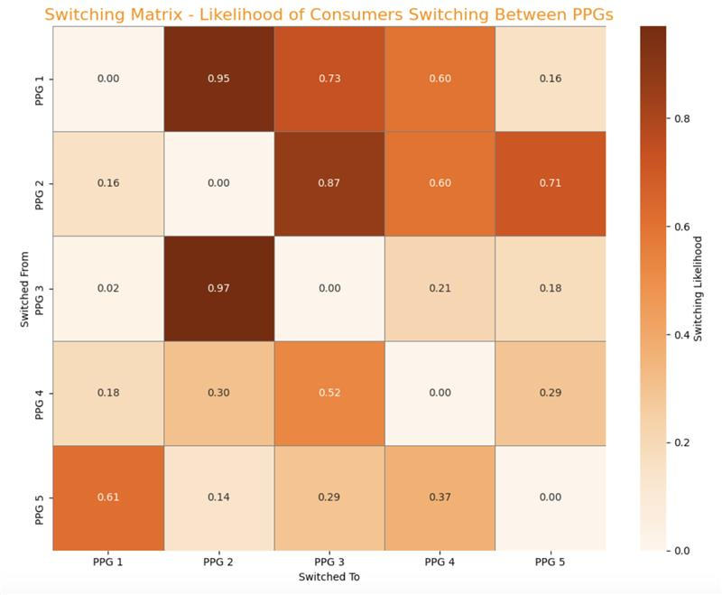






4. Modeling & Insights
Brand Switching Matrix which is based on survey data (Ipsos and Brandwatch) Can Also Provide Another Perspective On Shopper Attitude On Brands Switching
Illustrative
Switching Matrix Availability -
TSNE Model & Euclidean Distance
+
Market Share Correlation
Sourced Directly from Surveys & 3rd Party Data Sources
Derived Switching Matrix using Historical POS (Volume & Price) Data
Switching Matrix Analysis Benefits -
Quantifies Cannibalization Risk (Volume shift within and outside the portfolio)
Optimal Pricing Strategy (Minimizing self cannibalization and maximizing cross-cannibalization)
Simulates Consumer Switching Behavior & Demand Transfer (Pack size & Portfolio Optimization)

Slide 8
5. Simulation & Optimization
From What-If to What Matters: Forecasting Sales with Simulation
Illustrative
PPG Level
OUTPUT SECTION
BASELINE VALUE
SCENARIO SLIDER
SCENARIO VALUE
Baseline Volume (Oz)
Scenario Volume (Oz)
% change
Price ($)
20
-100%
+100%
22
500,000
510,000
2%
Discount (%)
55
60
Business Outcome
-100%
+100%
Baseline Value ($)
Scenario Value ($)
% change
TV Spend ($)
500,000
450,000
17,500,000
17,885,000
2.2%
Simulate “what-if” scenarios across pricing, promo, and media to support strategic planning
Identify optimal spend levels across levers to maximize sales and margin
-100%
+100%
Digital Spend($)
1,000,000
1,100,000
-100%
+100%
Promo Spend 1 ($)
Sales Decomposition- Baseline
Sales Decomposition- Scenario
200,000
400,000
-100%
+100%
Promo Spend 2 ($)
100,000
120,000
-100%
+100%
Seasonality
1.05
0.9
-100%
+100%
Simulate
Press “Simulate” for future outcomes
Set the scenario value for variables
Baseline Values calculated for last 12 months
The scenario planner quantifies the ROI of key commercial levers—like media, pricing, and promo spend—by simulating their impact on sales. Stakeholders can adjust inputs in real time to visualize outcomes and make data-backed investment decisions
*All figures shown are indicative and intended solely for representation

Slide 9
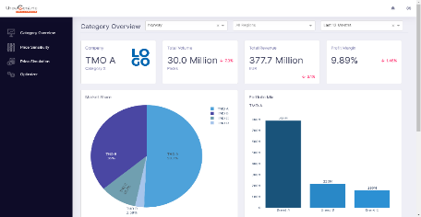
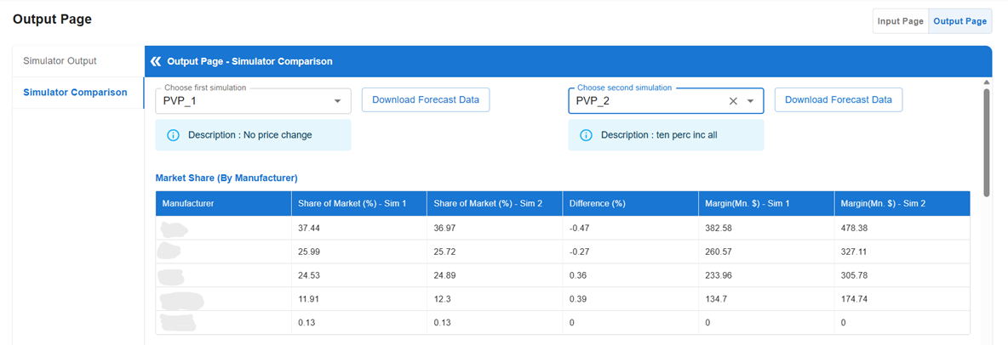
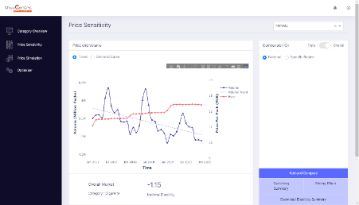
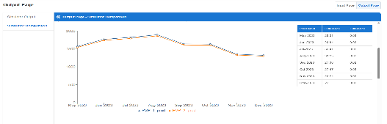
Forecasting & Pricing Capability development for a Global Tobacco Major
Problem Statement
Understand the impact of changing prices on product volumes and accordingly define the right pricing strategies for client’s product portfolio across geographies
Solution Snapshots
Approach and Solution
Developed a price predictor and simulation solution. Key components include :
Forecasting engine to predict volumes for the next two years
Cross elasticity estimations using switching matrix to understand volume transfer across SKUs
Simulation tool to run pricing scenarios
Business Impact
The solution allows the client to forecast market volumes and see the impact of various pricing strategies for their portfolio not limiting them to investigate only their own price change impact, but also the competition pricing moves such that they can see the overall market volume and share evolution from a pricing view

Slide 10




Promo Simulator – Forecast future sales and uplift as a function of different promotion types for various product categories for a Transnational CPG Major
Problem Statement
The demand planners needed a data driven AI/ML solution to anticipate the uplift in demand due to application of various Building-Block(s) such as Trade Promotions, and price changes
Along with the anticipated uplift on demand, they also required the volume contributions from each of the Building-Block(s). In addition, the baseline forecasts had to be robust and incorporate both seasonality and recency features
Approach and Solution
Due to the high volume of data, Thoucentric chose big data technology to process the data and bring it in analytics ready format.
Post data pre-processing and exploratory data analysis, Thoucentric choose the right forecasting level.
We generate baseline forecast for ~1 million time-series for next 3 months every month.
~1500 machine learning models were trained and used for generating the explainable simulations.
The entire solution is hosted on the client's Azure Cloud and enables demand planners to perform real time simulations on the go.
Business Impact
Enables the demand planners to construct informed demand plan with accuracy ranging between 65% - 70%
Real time simulation of various building blocks as inputs
The solution is hosted on the client’s cloud platform

Slide 11
We built a Pricing Decision Support System for a leading tobacco manufacturer to enable ‘Right Thinking’ pricing decisions across geographies
Problem Statement
Solution Approach
Solution Benefit
Understand the impact of changing prices on product volumes and accordingly define the right pricing strategies for Client’s product portfolio across geographies
Developed a price predictor and simulation solution. Key components include :
Cross elasticity estimations using switching matrix to understand volume transfer across SKUs
Forecasting engine to predict volumes for the next two years
Simulation tool to run pricing scenarios
Significantly reduced new market deployment time
Ease of decision making and potential savings
The solution comprises three key components that helps to generate forecasts based on pricing scenarios
Price Elasticity
Volume Transfer
Baseline Forecasts
Estimate change in the volume based on price responsiveness
Isolate impact of SKU price from trend, seasonality, competitor prices, economic and other external factors
Log-Log models are built to estimate elasticity at SKU – Region granularity
Insights on volume movement amongst all SKUs internally as well as movement across competitor SKUs
Switching matrix based on conjoint based primary research to understand consumer brand switching behaviour
Capture market trends and seasonality to simulate volume for the current year and next year
Baseline forecasts adjusted by seasonality and other trends

Slide 12
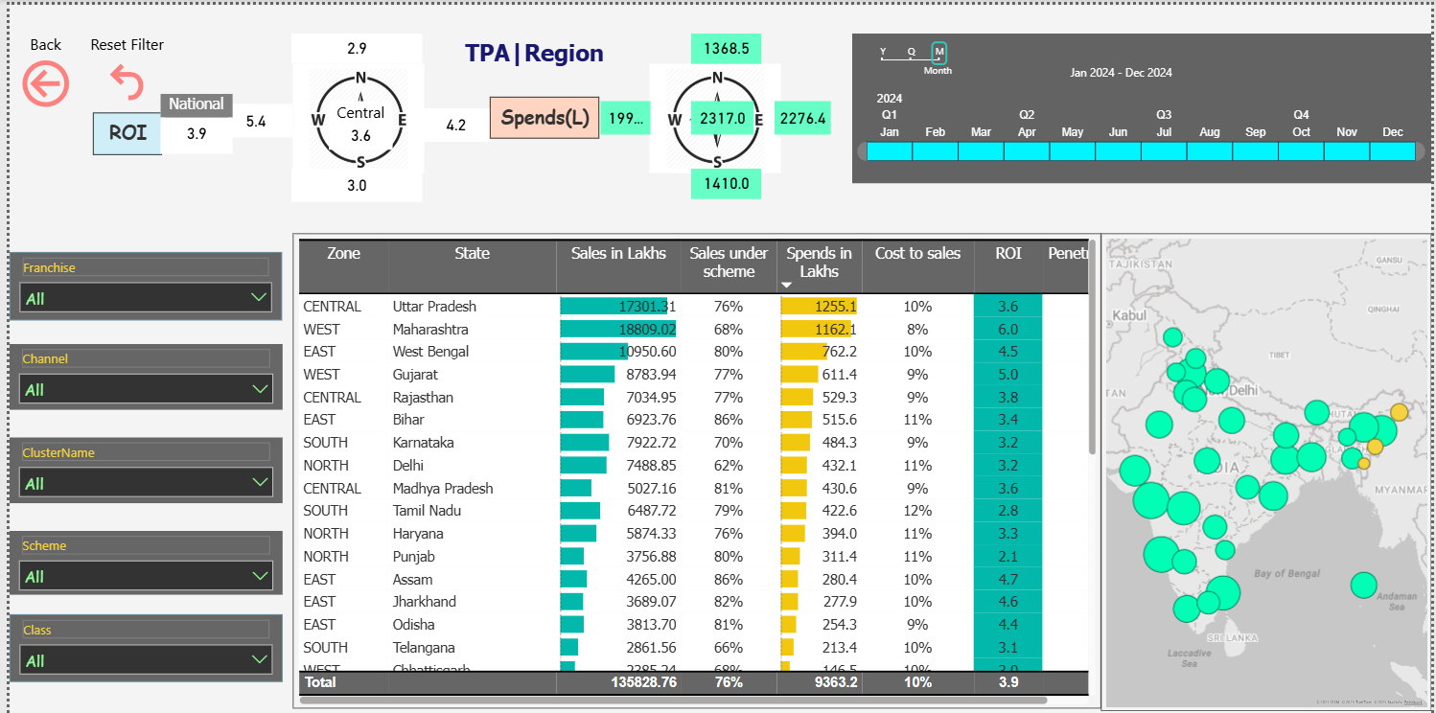
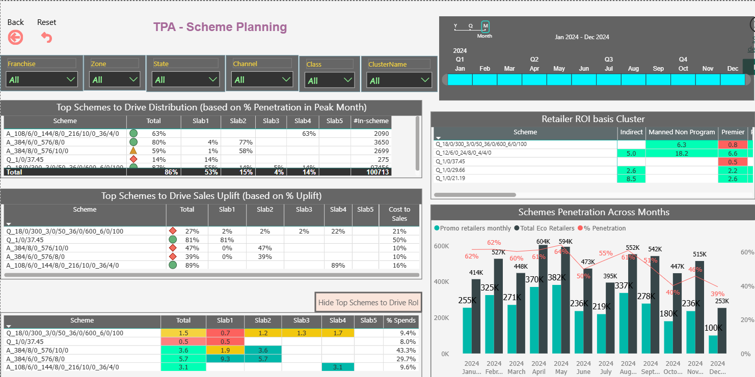
Trade Promotions analyser for a Global Cosmetics Leader
Problem Statement
Solution Snapshots
To develop an analytical tool to optimize trade scheme planning and drive sales growth
Approach and Solution
Developed a A/B testing solution for ROI and uplift estimation. Key components include :
Test-control groups creation engine based on statistical ideas
KPI calculation solution for each promotion by region and channel
Comprehensive Power BI dashboard visualizing the KPIs at various levels and slices
Business Impact
The solution allows the client to analyze the impact (uplift and ROI) of promotions run across the market portfolio to discontinue those without sufficient gains leading to cost savings. It also provides valuable insights on the type of promotions that are successful in different regions and channels.

Slide 13

Why us?
What we can help you with?
Proven Experience of developing solutions for Fortune 500 companies
Maximize Promo ROI
Developed a dynamic price elasticity engine for a Fortune 500 CPG Firm, delivering a 6% increase in uplift in revenue realization through optimized promotion investments.
Avoid Over-Discounting
Built advanced consumer promo optimization models, leading to a 4% uplift in revenue realization for a cosmetics giant enabling smarter promotion planning.
Channel-Specific Optimization
Future-Proof Promo Planning
Deployed elasticity-based promotion frameworks for a Tobacco giant, driving a 4% increase in uplift in net revenue through targeted discount and channel optimization.
Enhance Revenue and Margin Growth
How we add value?
Elasticity Modeling Expertise
Channel-Specific Promo Optimization
Full Promo ROI Frameworks
"What-If" Scenario Modelling
Rapid MVP Deployments
Proven CPG Track Record
© Proprietary & Confidential- Thoucentric. All rights reserved.

